Slide 1
Visualizing Employee Attendance Trends with Excel Charts
STUDENT NAME :K.Raajadurai
REGISTER NUMBER:312211660
DEPARTMENT :BCOM general A
COLLEGE:: THIRUTHANGAL NADAR COLLEGE

Slide 2
PROJECT TITLE:
Visualizing Employee Attendance Trends with Excel Charts

Slide 3
AGENDA
1.problem statement 2.project overview 3.end users 4.our solution and proposition 5.data description 6.modelling approach 7.result and discussion 8.conclusion

Slide 4
Project overview :
Employee Attendance Trend Analysis Project” Description: Outline the project’s objectives, scope, and timeline.

Slide 5
End users:
Stakeholders and End Users” Description: Identify the stakeholders and end users of the analysis, such as HR, management, and team leaders.

Slide 6
Our solution and proposition:
: “Data-Driven Attendance Insights with Excle Charts Description: Explain how Excel charts can help visualize and analyze employee attendance trends.

Slide 7
Data description:
Attendance Data Overview” Description: Describe the data used for analysis, including: Data sources (HR systems, attendance logs) – Variables (employee ID, dates, attendance status,etc.) Data quality and pre-processing steps

Slide 8
Modelling approach :
: “Visualizing Attendance Trends with Excel Charts” Description: Outline the modeling approach, including: Chart selection (e.g., heat maps, bar charts, line graphs) Data aggregation and grouping Chart customization and formatting

Slide 9

result and discussion:
 | Catering Invoice Sabrosa Empanadas & More 1202 Biscayne Bay Drive Orlando, FL 32804 | Invoice #: 5686B Date: 05/10/16
SERVICE | DESCRIPTION | LINE TOTAL
Menu Order | Food & beverage
Paper Goods | Plates, utensils, cups | $110.87
Rental Equipment | Tables, chairs, linens | $249.95
Service Fee | 18% of food & beverage | $0.00
TOTAL |  | $360.82

Slide 10
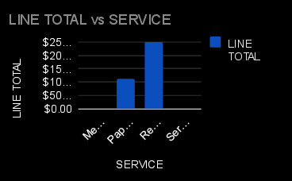
Par chart:

Slide 11
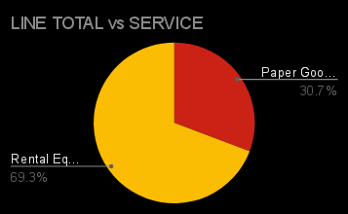
Pie chart

Slide 12
Conclusion:
Title: “Conclusion and Recommendations” Description: Summarize key findings, implications, and recommendations for improving employee attendance and management practices

